Slide 1
Building Hope…
A Charter School Facilities Fund
Developing Wisely. Doing Good. Building Hope.

Slide 2
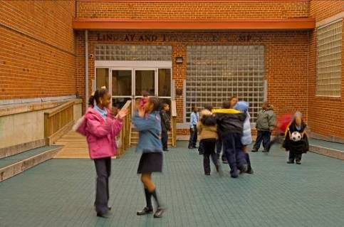
The Role We Play
Building Hope assists public charter schools with facility acquisition,
renovation, construction, and financing.
Our services include:
Real Estate Financing
Direct Lending and Credit Enhancement
Pro Bono Technical Assistance
Incubator Facilities
Project Management Services
Business Services

Slide 3
History of Charter School Facilities in D.C.
1996
2002
2013
Whatever schools could find
Strictly focused on
commercial markets:
Office space/ Industrial parks
Churches/Community Center
Surplus DC School buildings
Focused on reuse of former DCPS locations:
Incubator space
Co-location with DCPS
Lease of surplus DCPS buildings
Commercial market
There are many groups that specialize in charter school facilities.
We recommend you talk with experienced professionals
Talk to other charter schools that have been in your situation
Notes:
Board Member with RE Knowledge
There is a delicate balance having a board member knowledgeable about real estate. Many of them will be invaluable to help guide you through the process. Others will think that because they work in real estate, they know everything about charter school real estate, or worse, think they can do the job for you.

Slide 4
D.C. Charter School Solutions
Commercial Space/
New Development
Community Facility
Lease
DCPS Disposition
process
Incubator Initiative
Mature
School Demand
Early Stage
Private Facility
Public Facility
Building Supply

Slide 5
Determining Space Needs
General rules of thumb:
100 SF per student
Space planning exercise with an architect
There are a few architects that specialize in charter schools. Building Hope’s Technical Assistance Center can help facilitate this process for free
There are charter school facility specialists:
They can help with the brokerage process and new site development from the ground up.
We recommend you do not enter into an exclusive relationship with a broker. There are too many stories of schools who regret that decision.

Slide 6
Facility Budgeting
There are rules of thumb for facility costs:
Everything below is under the assumption of 100 square feet per student used for a building space.
Keep the annual facility costs (including operating costs) below the $3,072 per student facility funding level.
Operating costs average $7/SF or $700 per student. That leaves roughly $2,300 for lease/mortgage.
Renovation on existing property: construction costs range from $150-$190 per SF or up to $19,000 per student.
Brand new development: construction costs range from $250-$350 per SF or up to 35,000 per student.
Lease rates should be no more than $23 per SF for built space, or much less for space requiring build outs.

Slide 7
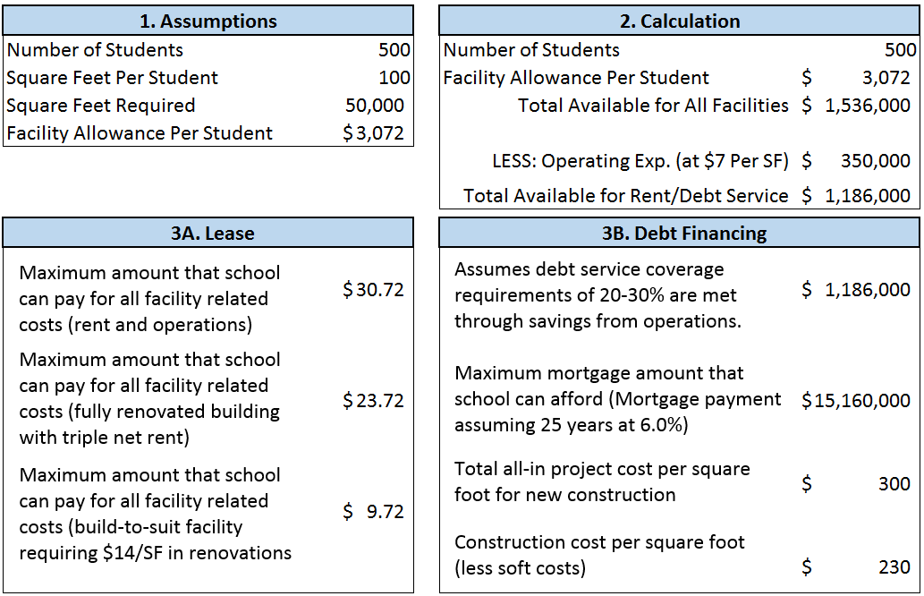
What can you afford?

Slide 8
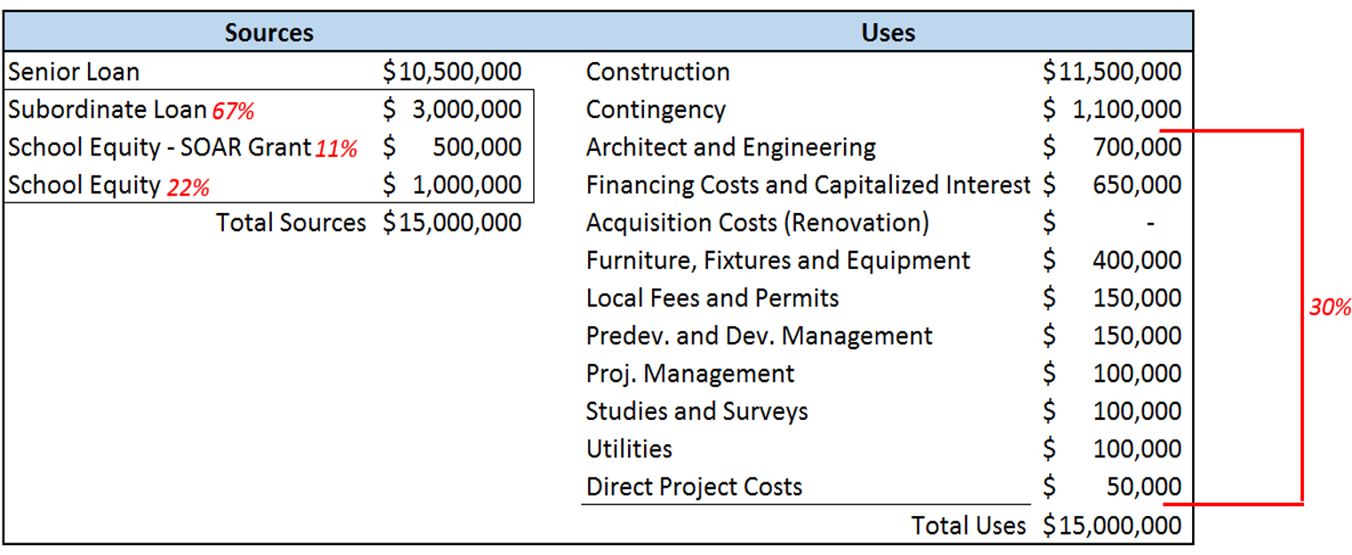
Sample Project Sources and Uses

Slide 9
Incubator Initiative
For start-ups, this may be the best alternative – quality space at affordable price
Public/private partnership between Building Hope and OSSE
Goal is to provide short term, affordable space for start up charter schools
Rent is based on (facilities allowance x number of students - 20% withholding) This is for new schools to use on other facilities-related items
Rent is full service and includes all costs except phone and internet, security,
and furniture and fixtures.

Slide 10
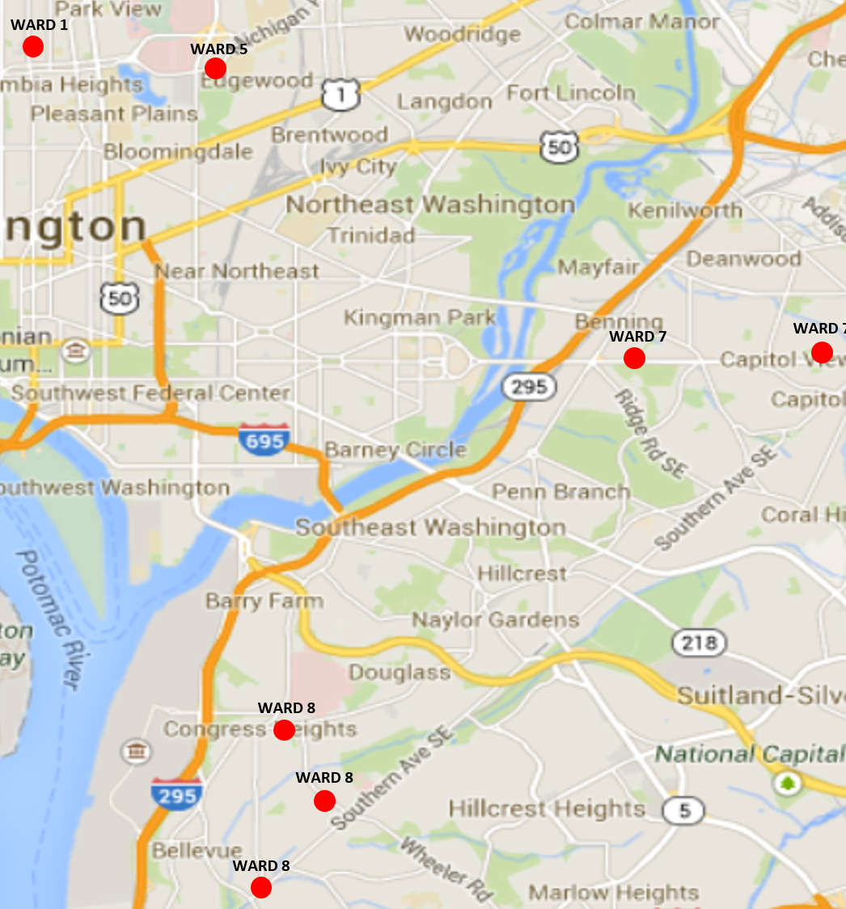
Incubator Initiative (cont’d)
Currently have 7 sites across the District
3029 14th Street NW (Ward 1)
100 41st Street NE (Ward 7) – former DCPS
908 Wahler Place SE (Ward 8) – former DCPS
4600 Livingston Road SE (Ward 8) – former DCPS
3301 Wheeler Rd, SE (Ward 8) – former DCPS
301 Douglas St., NE (Ward 5) – former DCPS
5601 E. Capitol St., SE (Ward 7) – former DCPS

Slide 11
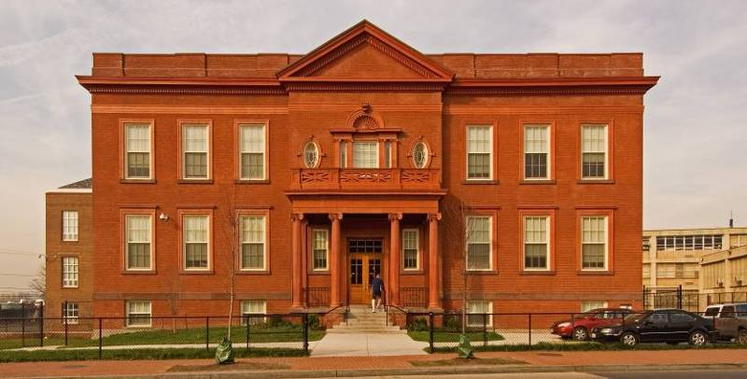
Real Estate Financing
Real estate/facility general considerations
Availability in marketplace
Affordability (“What can you afford?” slide)
Real estate trends – cost
Commercial vs. public
Lease vs. buy
Understand the proposed property transaction
Buy/Develop
Purchase of property: down payment; due diligence; letter of intent from bank
Building improvements: realistic projections of cost; realistic timeframe
Experienced project management team

Slide 12
Real Estate Financing (cont’d)
Lease
Term - $$ and years
Improvements: cost; bank considerations; guarantee
Option to buy
Understand the financing proposal – develop or lease
Quality of lender - type of commitment
Terms/covenants
Defaults/guarantee
Impact on future expansion
Relationships with lenders – may need in future for financing

Slide 13
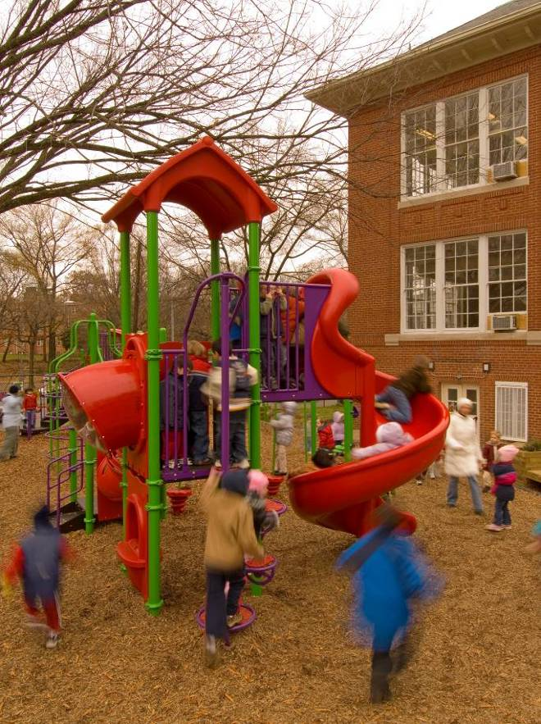
Lender’s Needs
Financial Statements and Budgets
Proforma: balance sheet
statement of operation
statement of cash flows
Financial & operating metrics
Previous Financial Audits (if applicable)
Make sure assumptions are realistic
Enrollment trends, demographics,
competition
Staff capabilities/trends
Facility size and cost
Fundraising goals

Slide 14
Lender’s Needs (cont’d)
Due Diligence
Organization: Mission, Strategic Plans
Academic performance: Metrics, Results, Adherence to contract
Management and Governance: Bios, Tenure, Minutes
Authorizer relationship: Approval documents, Renewal reports, Annual reports
Community Support: Parents, Community Organizations, Foundations
Project Details: Team, vendor bids, Pricing, Environmental reports
Financing: Bank considerations, credit enhancements, previous borrowing

Slide 15
Resource Centers
FOCUS has a Real Estate Advisory Center. Ask them for impartial advice (full disclosure: we are a member along with other facility solution providers). http://www.focusdc.org/real-estate-council
The National Charter School Resource Center has a website with access to numerous reports from around the country. http://www.charterschoolcenter.org/priority-area/facilities
Building Hope has a technical assistance center on its website with free tools and resources. Or call Tom Porter anytime for pro bono advice. http://www.buildinghope.org/
Contact: Tom Porter ● tporter@bhope.org ● 202-457-1991

