Slide 1
Person, Place, Thing: Understanding the Context of Community Violence
National CVIPI Resource and Field Support Center
March 14, 2024

Slide 2
Housekeeping
Thank you for joining us today!
Helpful links will be available in the chat
Please submit your questions and comments in the Q&A box or in the chat
Any additional questions, send through our TTA request portal: lisc.tfaforms.net/941

Slide 3
Housekeeping
This webinar is being recorded and will be available online: https://www.lisc.org/cvipi/
Turn on captions using the menu at the base of your screen
Join the conversation online with #CVIStrengtheningCommunities

Slide 4
Agenda
Engaging with the National CVIPI Resource & Field Support Center
Setting the Foundation:
Defining CVI
CVIPI Implementation Checklist
Collect and analyze data
Panel Discussion on CVI’s Focus on People and Place
Q&A

Slide 5
National CVIPI Resource and Field Support Center
Featured Topics
Engaging community members and fostering community leadership
Using data to identify problems and evidence-informed solutions
Finding the right partners and working effectively in collaboration
Planning and implementing CVI approaches that integrate with other community efforts
Evaluating and sustaining CVI efforts
CVI Resource Tools
Upcoming Trainings/Conferences
Community of Practice
Opportunity to Engage CVI Experts

Slide 6
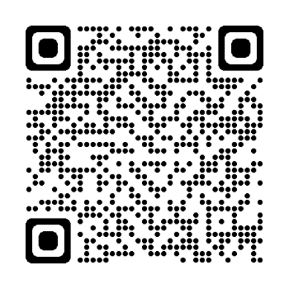
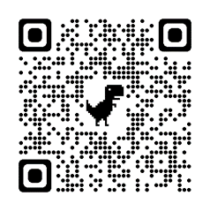
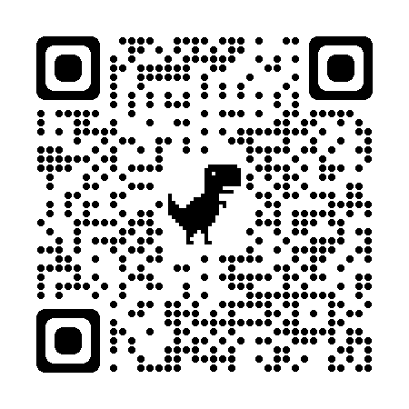
National CVIPI Resource and Field Support Center
National CVIPI
Website
CVIPI Training & Technical Assistance Request
CVIPI Community of Practice

Slide 7
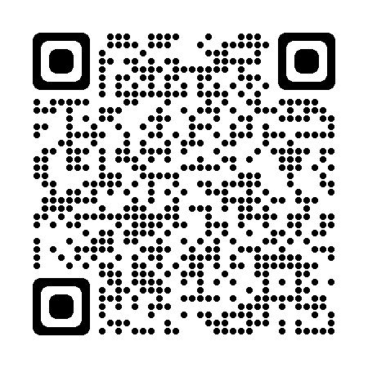
CVIPI Checklist Tool
CVIPI Implementation Checklist
CVIPI Checklist Steps
Step 1: Engage Community Members and Conduct a Community Violence Assessment.
Step 2: Form a Community Collaboration.
Step 3: Implement CVI.
Step 4: Set CVI Up for Success
Step 5: Measure Success.
Step 6: Sustain Success and Continuous Improvement.

Slide 8
Defining Community Violence Intervention
Community Violence Intervention (CVI) is an approach that uses evidence-informed strategies to reduce violence through community-centered initiatives
These multidisciplinary strategies engage individuals and groups to disrupt cycles of violence and retaliation, and they establish relationships with individuals and community assets to deliver services that address trauma, provide opportunity, and improve the physical, social, and economic conditions that drive violence

Slide 9
Defining Community Violence Intervention
Community Violence Intervention (CVI) is an approach that uses evidence-informed strategies to reduce violence through community-centered initiatives
These multidisciplinary strategies engage individuals and groups to disrupt cycles of violence and retaliation, and they establish relationships with individuals and community assets to deliver services that address trauma, provide opportunity, and improve the physical, social, and economic conditions that drive violence

Slide 10
CVIPI Checklist Tool
Stakeholder Partnership
Build CVIPI Capacity
Determine CVIPI Approach
Program Evolution / Sustainability
Community Engagement
Needs Assessment
Historical Landscape Analysis
Crime Data Public Health
Data Collection
Community Violence Intervention Approach
Community Partner Data

Slide 11
CVIPI Checklist Step 1.1: Get Community Input
Engage community stakeholders
Create inclusive training opportunities
Offer multiple entry points for participation
Acknowledge planning fatigue and skepticism

Slide 12
CVIPI Checklist Step 1.2: Collect and Analyze Data
Community-Based Organizations
CVI Organizations
Law Enforcement
Community Health (hospitals, local health centers, community health workers)
Government Agencies (Mayors Office, schools)
Neighborhood/Resident Organizations
Compile data and perform an in-depth community violence assessment that identifies the people and places involved in violence, the root causes of violence, assets that can support the CVI strategies, and gaps/needs to be addressed.

Slide 13
CVIPI Checklist Step 1.2: Collect and Analyze Data
Utilize Multiple Data Sources and Types (Quantitative/Qualitative)
Who is involved in community violence?
Where is community violence occurring?
When is community violence taking place?
Why is taking places at certain specific locations?
What are the underlying causes of community violence?
Are there policies and protocols in place that are working (or not working)

Slide 14
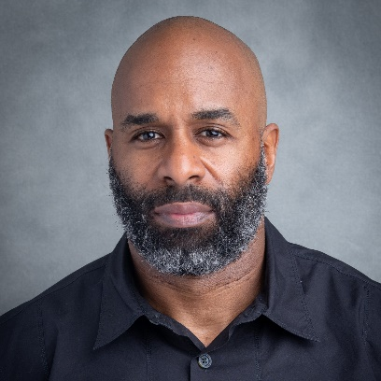
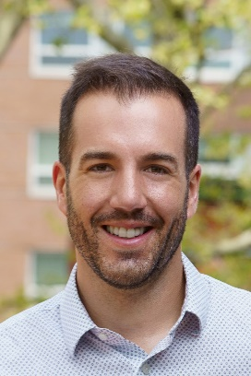
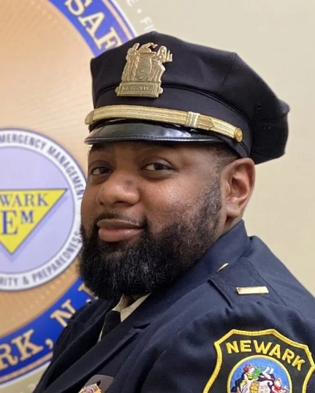
Person, Place, Thing: Understanding the Context of Community Violence
Rey Chavis
Director of High-Risk Intervention, Newark Community Street Team
Dr. Alejandro Gimenez Santana
Co-Executive Director, Newark Public Safety Collaborative
Solomon Middleton-Williams
Deputy Director, Newark Community Street Team
Lt. Tremayne Phillips
Executive Officer, Newark (NJ) Police Department

Slide 15
Newark Community Street Team

Slide 16
About the Newark Community Street Team
Founded in 2015 by Mayor Ras J. Baraka as Newark’s community-based violence reduction strategy.
NCST draws upon an evidence-based, trauma informed approach to violence reduction and hires, trains, and deploys Outreach Workers and High-Risk Interventionists in the South and West Wards of Newark to:
Provide casework to those at greatest risk of becoming a victim or a perpetrator of violence
Engage in high-risk intervention, both mediating ongoing disputes that may result in violence and preventing retaliation
Offer Safe Passage at contracted schools
Provide support to crime survivors who are overlooked by traditional victim services agencies.

Slide 17
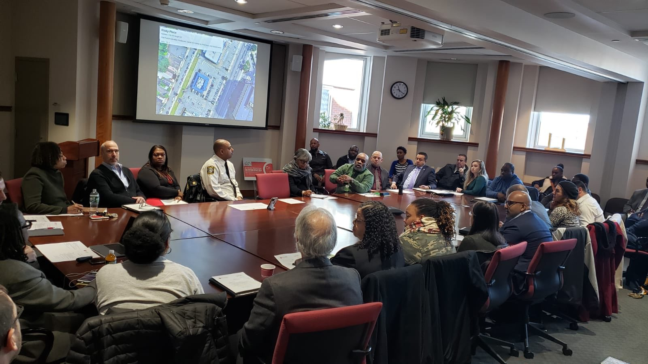
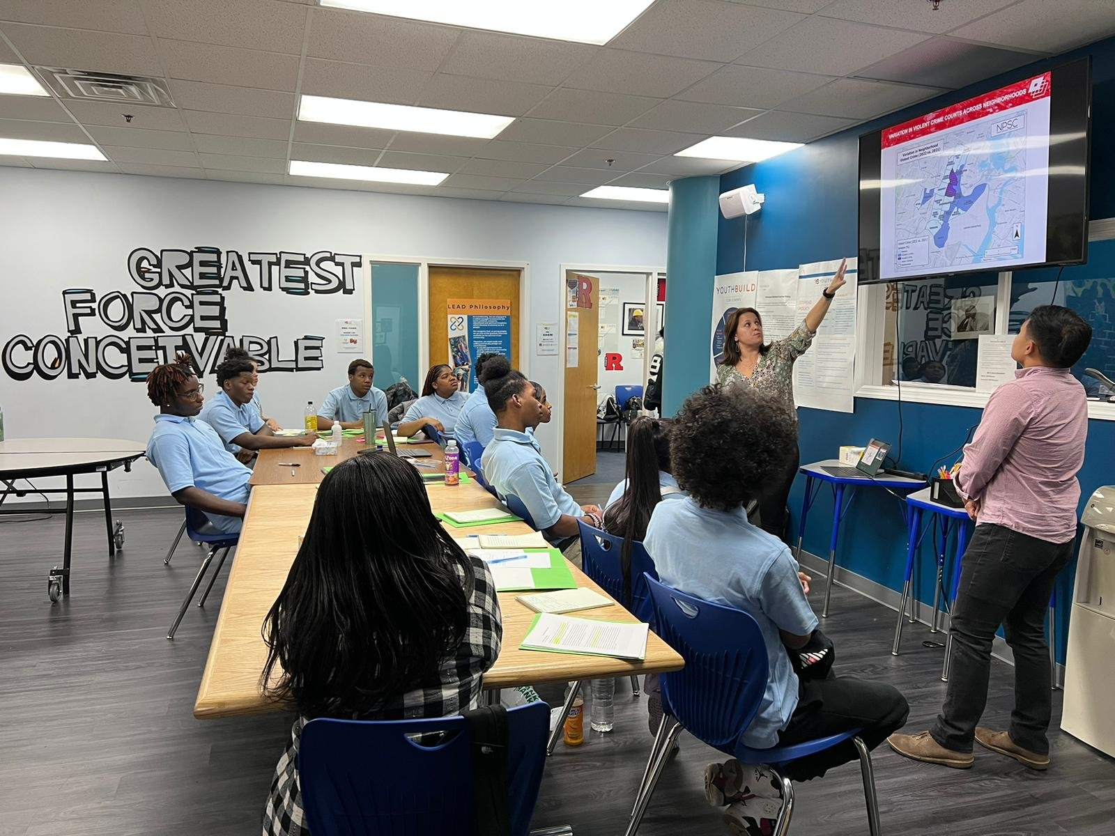
Newark Public Safety Collaborative
Housed in the Rutgers University – Newark’s School of Criminal Justice (SCJ) and convened by SCJ faculty.
Uses Data-Informed Community Engagement (DICE) to:
Democratize the use of data and analytics,
Mobilize community resources and expertise to problem-solve Newark’s most pressing crime issues.
Empower community organizations to become co-producers of public safety

Slide 18
About the Newark Public Safety Collaborative
NPSC levels the playing field by soliciting and valuing the input of those who understand the local context and have the resources to help create sustainable solutions.
NPSC organizes data-informed community engagement meetings every 60 days.
These structured one-hour open forum meetings begin with a discussion on crime trends, changes in the spatiotemporal distribution of crime, and multiple data analyses.
A discussion follows the presentation of each crime problem to discuss potential solutions, programs, or strategies to be implemented.

Slide 19
CVIPI Focus On People and Place
CVI requires communities to determine a process that allows them to direct resources to the people and places driving community violence.
Potential Process Steps for CVI:
Consider MOU’s to define how and when data is to be collected and analyzed
Ensure strategies and resources are engaging the right people
Identify the specific places where violence often occurs
Check for biases in the data to mitigate their influence
Engage technical assistance partners or local research institutions that can provide support/cross-training to CVI team and staff

Slide 20
Thank you and Q&A
We want to answer your questions! Please raise your hand or type in questions in the Q&A or chat box.
Visit the National CVIPI Resource and Field Support Center:
www.lisc.org/cvipi
For follow up information: safety@lisc.org

