Slide 1
LISC NYC
Small Business Learning Session
Tuesday, March 1, 2022

Slide 2
LISC NYC Mission
Local Initiatives Support Corporation (LISC) is a national, nonprofit community development financial institution (CDFI) that equips underinvested communities with the capital, strategy, and technical know-how to become places where low- and moderate-income (LMI) people can thrive.
LISC NYC, LISC’s flagship New York City office, was created in 1980. Over the past 40 years, LISC NYC has supported local partners whose services and programs aim to create a more equitable, inclusive, and sustainable New York City.
LISC NYC believes that the time has come to forge a future for New York City that eradicates the racial wealth gap for good, protects affordable housing for LMI New Yorkers, and builds pathways of meaningful economic opportunity for all.

Slide 3
LISC NYC Platform
LISC NYC’s platform consists of three pillars that inform all of our programmatic and lending efforts.
Radical Healing
Examine and address underlying assumptions that perpetuate bias and bigotry through:
legislative and public policy advocacy; and
engagement with cultural institutions (for example, through community arts and placemaking efforts).
2. Inclusive Economic Transformation
Prioritize targeted investments in:
public infrastructure;
human talent;
innovation;
diverse small businesses; and
impactful community organizations.
3. Sustainable Wealth Generation
Explore and implement programs that support:
entrepreneurship;
ownership;
career ladders; and
financial mobility and wealth building in communities of color.

Slide 4
Priority Areas
LISC NYC is catalyzing the ecosystem of supports for BIPOC-owned small businesses and communities to overcome systemic barriers and build sustainable wealth.
AFFORDABLE HOUSING
ECONOMIC DEVELOPMENT
WORKFORCE DEVELOPMENT/ FINANCIAL MOBILITY
HEALTH EQUITY

Slide 5
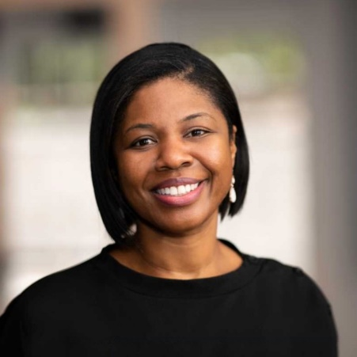
Learning Topic: Business 201- Building a Foundation that Lasts
Chase for Business to discuss vital components for entrepreneurs seeking to build a lasting business foundation. Some of the topics to be covered will include:
Thinking Like an Entrepreneur
Developing Agility and Resilience
And other topics related to business fundamentals
Jumoke “Joy” Fagbayi-Butts
Vice President- Senior Business Consultant Minority Entrepreneurs
Contact: jumoke.m.fagbayi@chase.com
Phone: 908-376-6536

