Slide 1
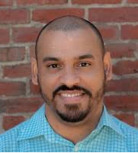
Beyond Six-Feet-Apart Accelerator Expert Webinar Series on Reopening Topics
Purchasing Personal Protective Equipment (PPE) Wed. June 10, 5:00-6:30 p.m.
Register Now
Pedro Soto
Planning Director
City of Lawrence
Shamika Rucker
Founder and CEO The Wellness Co.
Reopening strategically and safely means purchasing PPE, which may be in high demand and short supply. We’ll hear how the City of Lawrence procured PPE for its small businesses, how ProtectMA is connecting buyers to minority-owned PPE producers, how one business owner pivoted her business to become a PPE supplier, and we’ll discuss purchasing solutions for small businesses.

