Slide 1
Getting to Know LISC NYC
Fall 2020

Slide 2
Pre-COVID “Normal” Was Not Working for Most New Yorkers. 2020 has been marked by devastating crises for underserved New York City communities, from Mott Haven to Brownsville to the Rockaways. The COVID-19 pandemic is crushing our city’s small businesses, rent-burdened tenants, and LMI workers and families. Public demands for systemic racial justice can no longer be ignored. This is a defining moment to close New York City’s racial wealth gap – permanently. LISC NYC is committed to shaping this inclusive future in partnership with allies and funders.

Slide 3
LISC NYC Mission
Local Initiatives Support Corporation (LISC) is a national, nonprofit community development financial institution (CDFI) that equips underinvested communities with the capital, strategy, and technical know-how to become places where low- and moderate-income (LMI) people can thrive.
LISC NYC, LISC’s flagship New York City office, was created in 1980. Over the past 40 years, LISC NYC has supported local partners whose services and programs aim to create a more equitable, inclusive, and sustainable New York City.
LISC NYC believes that the time has come to forge a future for New York City that eradicates the racial wealth gap for good, protects affordable housing for LMI New Yorkers, and builds pathways of meaningful economic opportunity for all.

Slide 4
LISC NYC Platform
LISC NYC’s platform consists of three pillars. They are backed by intention and strategy and inform all of LISC NYC’s programmatic and lending efforts.
Radical Healing
Examine and address underlying assumptions that perpetuate bias and bigotry through:
legislative and public policy advocacy; and
engagement with cultural institutions (for example, through community arts and placemaking efforts).
2. Inclusive Economic Transformation
Prioritize targeted investments in:
public infrastructure;
human talent;
innovation;
diverse small businesses; and
impactful community organizations.
3. Sustainable Wealth Generation
Explore and implement programs that support:
entrepreneurship;
ownership;
career ladders; and
financial mobility and wealth building in communities of color.

Slide 5
LISC NYC Performance Snapshot YTD 2020
$7.3 million invested
$118 million leveraged
Rooted Responders
25 community-based organizations (CBO) partners surveyed and report published
3 CBO leaders & Cashin Fellows featured in LISC NYC panel event addressing COVID pandemic & racial justice
Partnerships fostered between CBOs and food- rescue nonprofit
Community-Based Partner Capacity Building
$500,000 in federal HUD Section 4 funding awarded to 14 CBOs
8 AmeriCorps members awarded to 7 CBOs
Capital Deployment Activity
$3 million in LISC and federal PPP loans
$3.2 million in small business relief grants
$292,000 in grants to CBOs for small business technical assistance
$250,000 in other grants to CBOs
Programs
Commercial Corridors
Small Business Relief (Technical Assistance)
Financial Opportunity Centers
Health Equity
New York Land Opportunity Program (NYLOP)

Slide 6
LISC NYC’s Reach
Key Partners
Our network includes community-based nonprofits, businesses, and government agencies in the New York City Area
Partners Engaged in 2020 (Partial List)
New Funders:
Macquarie Group
Two Sigma Investments
Anthem Foundation
Momentum Fund
Nonprofits:
Greater Jamaica Development Corporation
Harlem Park to Park
Long Island City Partnership
New York Women’s Chamber of Commerce
Rockaway Development and Revitalization Corporation
Uptown Grand Central
Government Agencies:
NYC Small Business Services (SBS)
NYC Dept. of Housing Preservation & Development
New York Empire State Development
NYC Dept. of Health and Mental Hygiene
U.S. Dept. of Housing & Urban Development

Slide 7
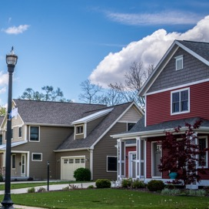
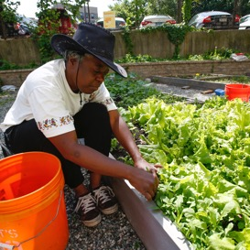
5 Priority Areas
LISC NYC is building an integrated community development platform.
AFFORDABLE HOUSING
ECONOMIC DEVELOPMENT
ROBUST LENDING PLATFORM
WORKFORCE DEVELOPMENT/
FINANCIAL MOBILITY
HEALTH EQUITY

Slide 8
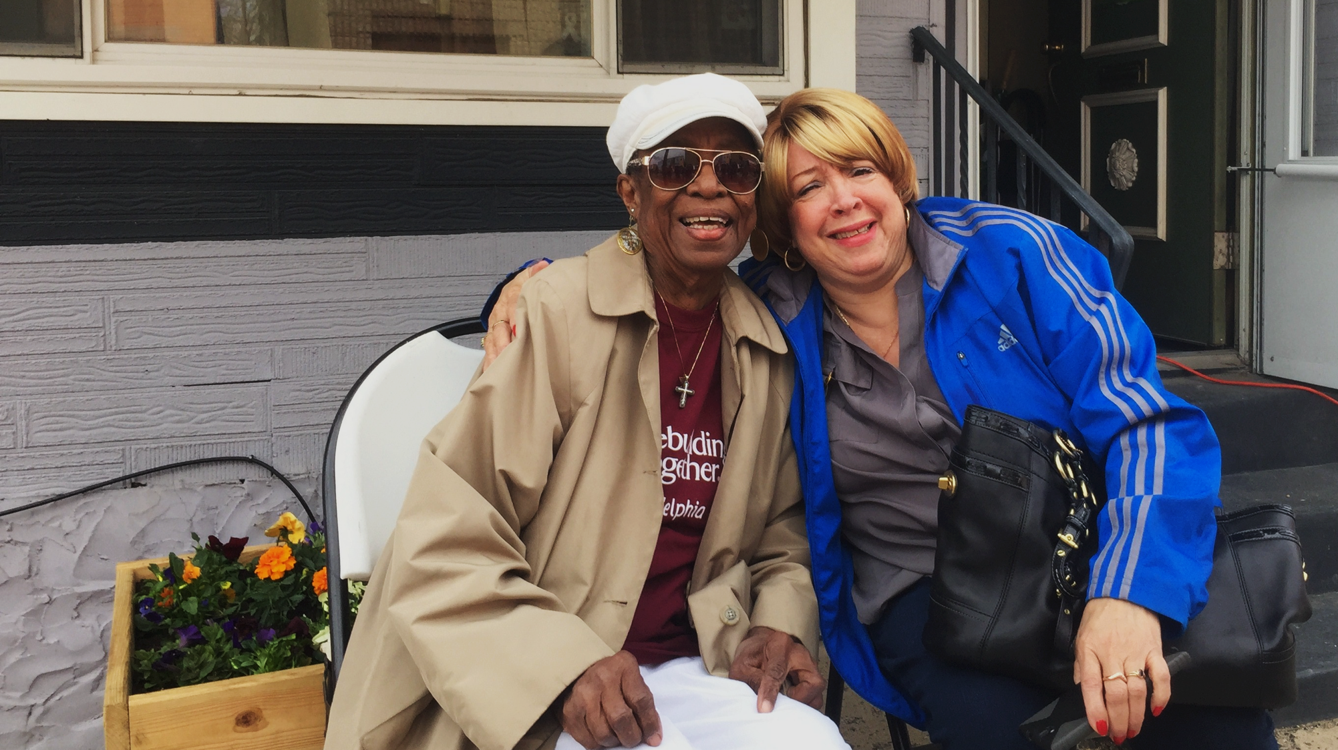
Affordable Housing

Slide 9
Affordable Housing
LISC NYC is capitalizing on the downturn of the NYC real estate market due to the COVID-19 pandemic and current economic conditions with the goal of growing its affordable housing portfolio through acquisition and new development.
Issues
Void left by reduced/lack of government subsidies for affordable housing finance
Lack of opportunity and access for emerging minority-owned developers to build pipeline of projects
Need to strengthen advocacy and coalition-building with housing finance to create acquisition opportunities for NYC community development corporations (CDCs)
Goals
Increase capacity for minority-owned business enterprise (MBE) developers through cohort-based training programs
Develop MBE and CDC partnerships for long-term community ownership
Create acquisition fund for property conversion from underutilized commercial real estate to permanent affordable housing
Develop new equity products and long-term debt financing tools by attracting social impact investors

Slide 10
Economic Development

Slide 11
Economic Development
LISC NYC is working to build strong, sustainable minority-owned businesses in underserved communities.
Issue
Need for diverse capital access including grants, loans and financial tools to grow and maintain sustainability
Need to expand technical assistance and increase capacity- building resources based on long- term relationships with CBOs
Goals
Raise capital for continued grant and loan support
Build a coalition of financial institutions for continued access to capital, insurance and bonding
Grow number and capacity of CBO partners for ongoing support and technical assistance

Slide 12
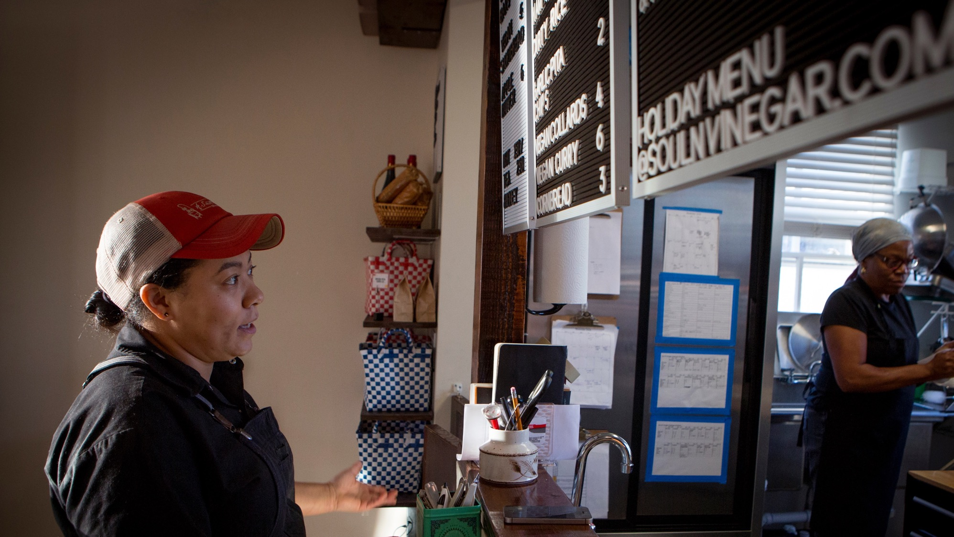
Robust Lending Platform

Slide 13
Robust Lending Platform
Expand the LISC NYC lending program to meet growing and dynamic needs of our communities
Issues
Identify key lending needs in communities we serve
Build portfolio of products to increase community lending market share
Increase LISC NYC competitiveness by rate reduction and other transaction concessions
Goals
Establish LISC NYC grant fund for credit enhancement and capital support
Capitalize LISC National Investment Fund Group resources for increased lending capacity

Slide 14
Workforce Development/ Financial Mobility

Slide 15
Workforce Development/Financial Mobility
Provide access to skill development and professional growth for historically underserved populations in sustainable industries; pair with access to financial mobility education, coaching, and assistance
Issues
Identify historic contributors to employment stagnation, disruption, and displacement for diverse segments of NYC communities
Innovate on LISC’s FOC model to create ladders and pathways to financial mobility for a range of NYC communities
Goals
Expand FOC sites in NYC market
Identity key stakeholders and partners to integrate FOC and workforce development concept for targeted cohort of 16-to-24 year-old justice-involved, Black and Latinx youth with the goal of removing barriers to personal wealth generation and financial mobility over the long term
Establish success metrics and operationalize review and evaluation processes

Slide 16
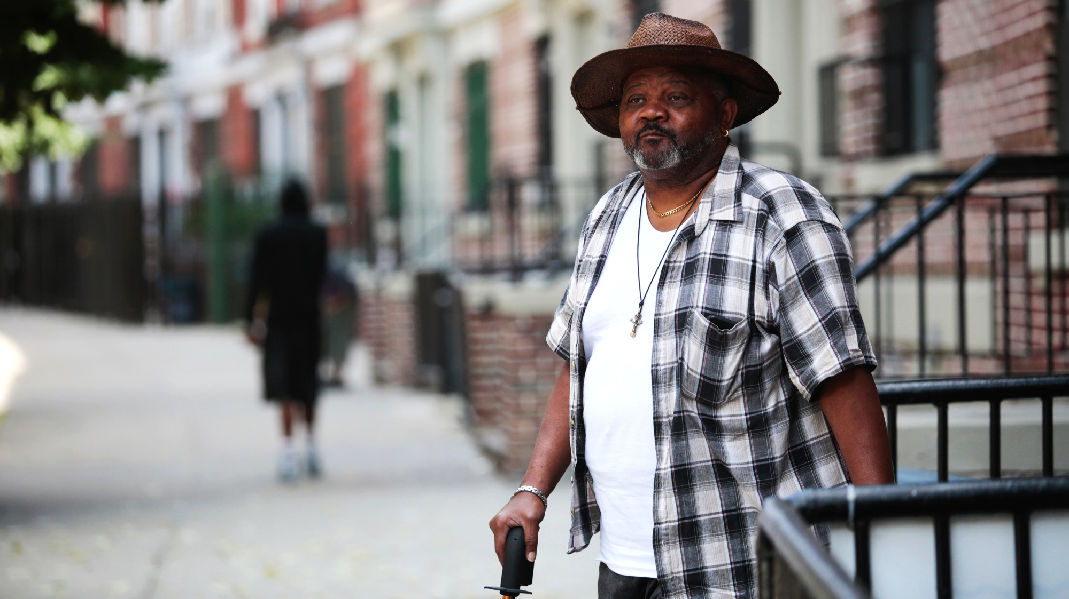
Health Equity

Slide 17
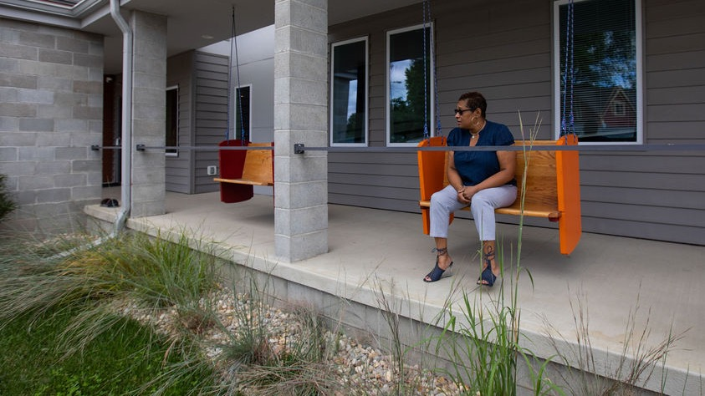
Health Equity
LISC NYC is working to promote a healthy environment with access to preventative health care and medical services that will support reduction in chronic conditions for members of disinvested communities
Issues
Identify systemic health inequities in underserved New York City communities
Provide intervention and health programming
Goals
Partner with key stakeholders in a pilot program to identify and address targeted conditions in selected communities
Commission a report analyzing the pilot results
Develop scalable program based on pilot results

Slide 18
Contact Us
Valerie White
Executive Director, LISC NYC
vwhite@lisc.org
Nisha Mistry
Director of External Affairs, LISC NYC
nmistry@lisc.org
Follow Us on Twitter
@LISC_NYC

